Slide 1

UNCLE MOSES
Ido Finzy Yossi Gelman Ron Raifer Sariel Sofer Mati Halfa
2nd Presentation - Solution
June 1, 2020
Applied English – Ort Braude – Nora Haj – Group #2

Slide 2


AGENDA
01
02
SHORT REMINDER
EVIDENCES
03
Who Are We
Short brief about the issues
from our previous presentation
Showing the results
that the problem caused
Representing Uncle Moses
company and it’s goals
04
05
06
SOLUTION
FINAL WORDS
END and Q&A
Finally, presenting an
appropriate solution to the problem
Summarize the issue
and showing conclusions
Ending our presentation
and answering questions

Slide 3

SHORT REMINDER
Agriculture In Israel
Term, history and now
Problem
Israel Farmer’s Federation
Brokerage fees the farmers have to pay in order to sell their goods
Represents the farmers across Israel, but prefers to focus on the big farms either then the small farms
Problem Causes
Result
Farmers are forced to reduce the prices
Brokerage fees damages the farmers and eventually leads them to bankrupt

Slide 4
EVIDENCES
42% DROP
Between 1981 to 1995
31% DROP
Between 1995 to 2017
27,052 LESS
Farms in 36 years
Many farmers are having financial difficulties due to the brokerage fees, which eventually leads them to bankrupt.

Slide 5

WHO ARE WE?
Uncle Moses company was founded in March 15th 2020 by bunch of software students who came from farmers families.
FOUNDING
Uncle Moses was established in order to help the entire farming industry in Israel including the small farmers.
REASON

Slide 6

WHO ARE WE?
Breaking markets monopoly
Stop the brokerage fees culture
Getting agriculture to the next level in the digital world
Conservation of the agriculture in Israel
GOALS
Notes:
Make clean profit to the farmers by making a direct connection between the customers and the farmers. The direct connection idea is to prevent extra payment for the brokerage.

Slide 7

Developing World
Notes:
In a world that develops every single day, old professions needs to transform their shape of work and adapt it to the digital world.

Slide 8

SOLUTION
Notes:
Prepare the ground to the solution (rhetorical question)

Slide 9
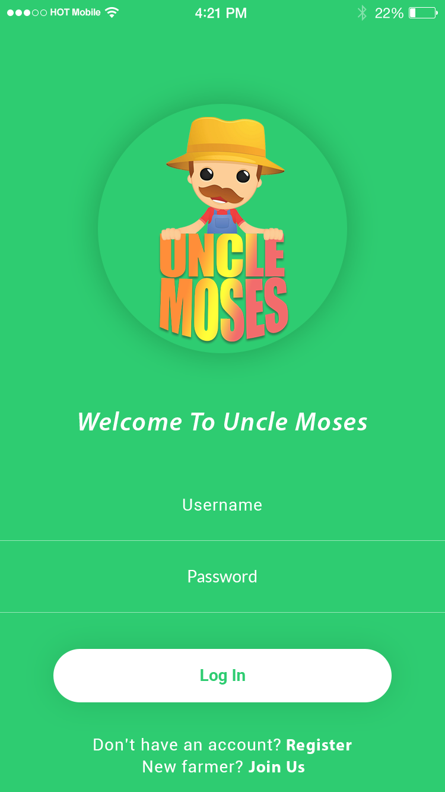
SOLUTION
We are proud to introduce
the Uncle Moses application
LOGIN AREA
Notes:
Prepare the ground to the solution (rhetorical question)

Slide 10
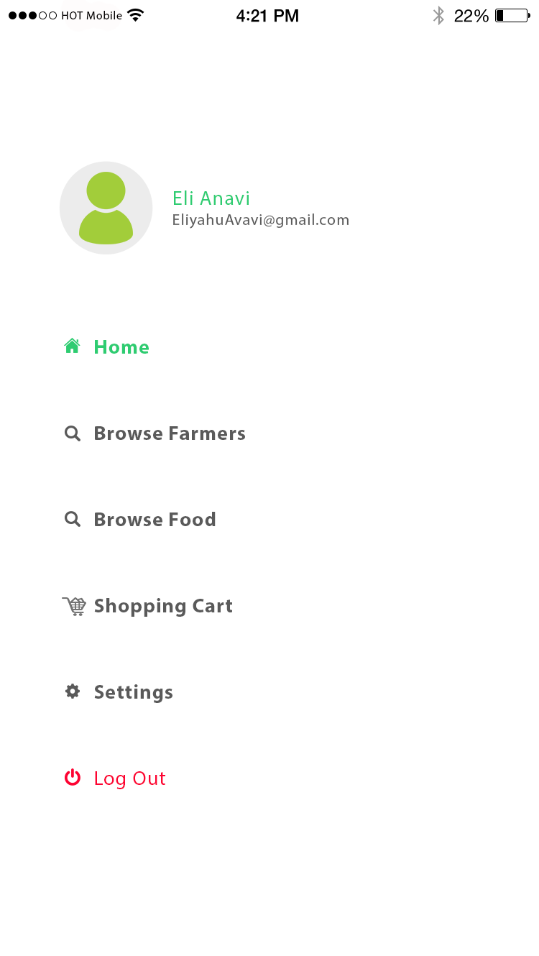
SOLUTION
MENU – CLIENT VIEW
Notes:
Prepare the ground to the solution (rhetorical question)

Slide 11
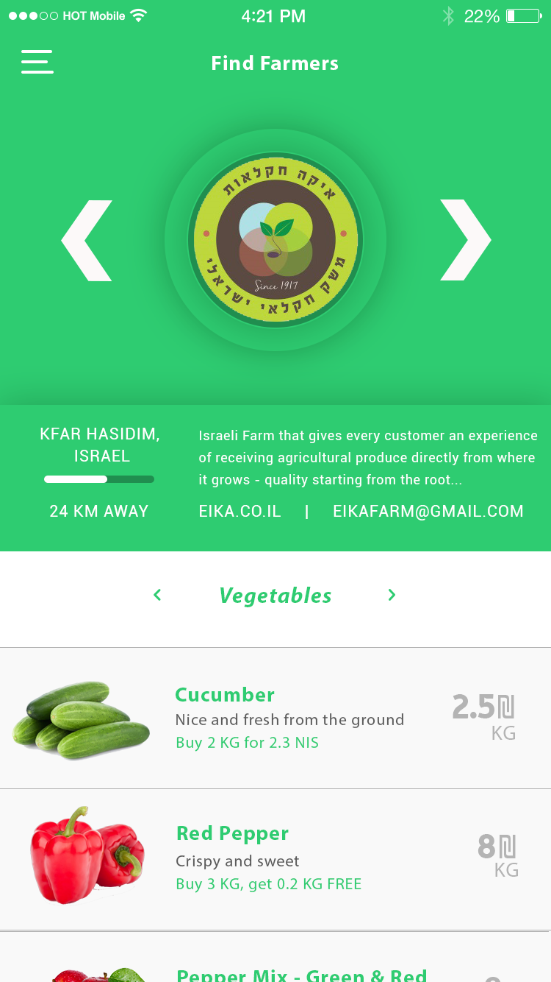
SOLUTION
FARMER SEARCH
Notes:
Prepare the ground to the solution (rhetorical question)

Slide 12
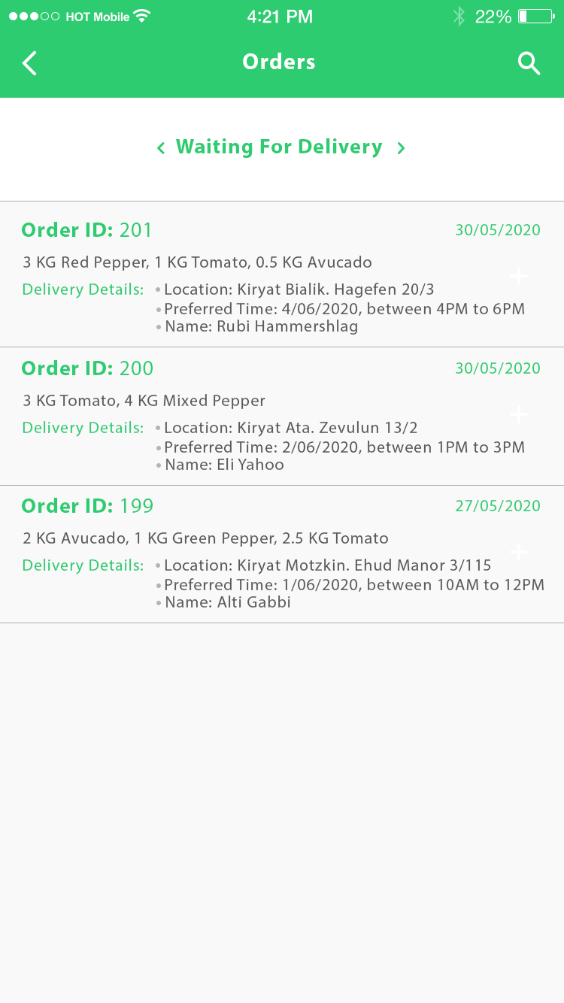
SOLUTION
FARMER MANAGE AREA
Notes:
Prepare the ground to the solution (rhetorical question)

Slide 13
FINAL WORDS
Brokerage fees
Causes many bankruptcies and financial difficulties for farmers
Available solutions
Do not seem to be satisfying
Our solution
Is the ultimate solution available in the market
Our solution gives a better future to this industry

Slide 14
https://mindsea.com/app-stats/
https://gett.com/il/about/
https://en.wikipedia.org/wiki/Agriculture
https://wiuag.wordpress.com/2017/11/06/agriculture-past-vs-present/comment-page-1/
https://en.wikipedia.org/wiki/Agriculture_in_Israel
https://old.cbs.gov.il/reader/newhodaot/hodaa_template.html?hodaa=202007018
BIBLIOGRAPHY

Slide 15
Any Questions?

Slide 16

Thank You,

